Slide 1
Guidelines on Rational use of Personal Protective Equipment- Novel Corona virus Disease 2019 (COVID-19)
State Institute of Health and Family Welfare-Rajasthan

Slide 2
Need of the PPE
Additional precautions are required by health care workers to protect themselves and prevent transmission in the healthcare setting.
Precautions to be implemented by health care workers caring for patients with COVID-19 include using PPE appropriately; this involves selecting proper PPE and being trained in how to put on, remove, and dispose of it
Reduce the risk of transmission of blood borne and other pathogens from both recognized and unrecognized sources.
Ref:-Rational use of personal protective equipment (PPE) for coronavirus disease (COVID-19) Interim guidance 19 March 2020

Slide 3
Presentation Useful For
Health care workers and others working in points of entries (POEs)
Quarantine centers
Hospitals
Laboratory
Community settings

Slide 4
Introduction-COVID-19
The outbreak of Novel coronavirus disease (COVID-19) was initially noticed from a seafood market in Wuhan city in China in mid-December, 2019, has spread to more than 185 countries/territories worldwide including India.
The causative agent for COVID-19, earlier termed provisionally as novel Coronavirus has been officially named as SARS-CoV-2.

Slide 5
Mode of Transmission
The people most at risk of COVID-19 infection are those who are in close contact with a suspect/confirmed COVID-19 patient or who care for such patients.

Slide 6
Personal Protective Equipment (PPE)
Personal Protective Equipments (PPEs) are protective gears designed to safeguard the health of workers by minimizing the exposure to a biological agent.

Slide 7
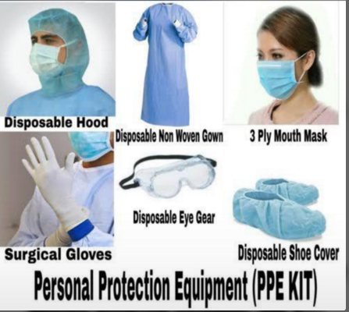
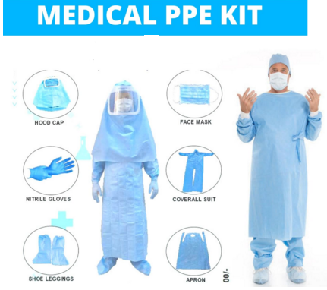
Components of PPE
Goggles
Face-shield
Mask
Gloves
Gowns
Head cover
Shoe cover

Slide 8
Face shield and goggles
Protection of the mucous membranes of the eyes/nose/mouth (droplets generated by cough, sneeze of an infected person or during aerosol generating procedures) by using face shields/ goggles is an integral part of standard and contact precautions.
The flexible frame of goggles should provide good seal with the skin of the face, covering the eyes and the surrounding areas and even accommodating for prescription glasses.
Ref: Novel Coronavirus Disease 2019 (COVID-19): Guidelines on rational use of Personal Protective Equipment

Slide 9
Masks
Coronaviruses target mainly the upper and lower respiratory tracts. The droplet precautions/airborne precautions using masks are crucial while dealing with a suspect or confirmed case of COVID-19/performing aerosol generating procedures.
There are two types of masks which are recommended for various categories of personnel working in hospital or community settings, depending upon the work environment:
1. Triple layer medical mask
2. N-95 Respirator mask
Ref: Novel Coronavirus Disease 2019 (COVID-19): Guidelines on rational use of Personal Protective Equipment

Slide 10
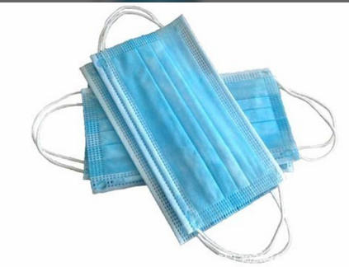
Triple Layer Medical Mask
A triple layer medical mask is a disposable mask, fluid-resistant, provide protection to the wearer from droplets of infectious material emitted during coughing/sneezing/talking.
Ref: Novel Coronavirus Disease 2019 (COVID-19): Guidelines on rational use of Personal Protective Equipment

Slide 11
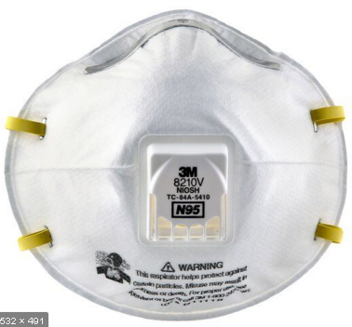
N-95 Respirator mask
An N-95 respirator mask is a respiratory protective device with high filtration efficiency to airborne particles.
Such mask should have high fluid resistance, good breathability (preferably with an expiratory valve), clearly identifiable internal and external faces, duckbill/cup-shaped structured design that does not collapse against the mouth.
If correctly worn, the filtration capacity of these masks exceeds those of triple layer medical masks.
Ref: Novel Coronavirus Disease 2019 (COVID-19): Guidelines on rational use of Personal Protective Equipment

Slide 12
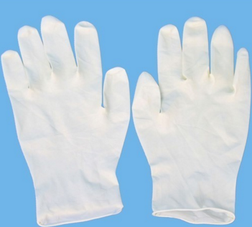
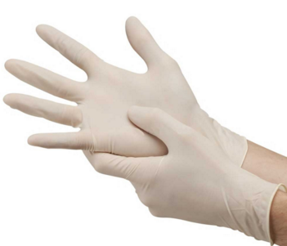
Gloves
To be a predominant mode of transmission, care should be exercised while handling objects/surface potentially contaminated by suspect/confirmed cases of COVID-19.
Ref: Novel Coronavirus Disease 2019 (COVID-19): Guidelines on rational use of Personal Protective Equipment

Slide 13
Gowns
Coverall/gowns are designed to protect of healthcare providers from exposure to virus.
Coveralls typically provide 360-degree protection because they are designed to cover the whole body, including back and lower legs and sometimes head and feet as well, the design of medical/isolation gowns do not provide continuous whole-body protection (e.g., possible openings in the back, coverage to the mid-calf only).
By using appropriate protective clothing, it is possible to create a barrier to eliminate or reduce contact and droplet exposure, both known to transmit COVID-19

Slide 14
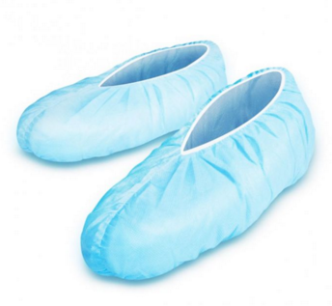
Shoe covers
Shoe covers should be made up of impermeable fabric to be used over shoes to facilitate personal protection and decontamination.

Slide 15
Head covers
Head cover that covers the head and neck while providing clinical care for patients. Hair and hair extensions should fit inside the head cover.

Slide 16
SEQUENCE FOR PUTTING ON PERSONAL PROTECTIVE EQUIPMENT (PPE)
Personal Protection Equipment (PPE) - Specifications

Slide 17
Ensure rational and appropriate use of PPE
PPE is only one effective measure within a package of administrative and environmental and engineering controls.
as described in WHO’s Infection prevention and control of epidemic- and pandemic-prone acute respiratory infections in health care.
These controls are summarized here.

Slide 18
Administrative Controls
Ensuring resources for infection prevention and control (IPC) measures, such as- appropriate infrastructure
Development of clear IPC policies
Facilitated access to laboratory testing
Appropriate triage and placement of patients
Adequate staff-to-patient ratios
Training of staff

Slide 19
Rational use of PPE
PPE should be used in combination with administrative and engineering controls.
PPE should be used based on the risk of exposure (e.g. type of activity) and the transmission dynamics of the pathogen(e.g. contact, droplet or aerosol).
The overuse of PPE will have a further impact on supply shortages.

Slide 20
PPEs to be Used in Different Settings
The PPEs are to be used based on the risk profile of the health care worker.
The document describes the PPEs to be used in different settings.

Slide 21
Minimize the need for PPE in health care settings
Wherever feasible, use telemedicine and telephone to initially evaluate suspected cases of COVID-19, thus minimizing the need for these persons to go to health care facilities for evaluation.
Use physical barriers to reduce exposure to the COVID-19 virus, such as glass or plastic windows such as -screening areas, the registration desk at the emergency department, or at the pharmacy window
Postpone elective, non-urgent procedure, and hospitalizations, reduce frequency of visits for chronic patients
Ref: Rational use of personal protective equipment for coronavirus disease (COVID-19) and considerations during severe shortages Interim guidance 6 April 2020

Slide 22
Designate dedicated health care workers/teams only for COVID-19 patient care so that they can use PPE for longer periods of time (extended use of PPE).
Restrict the number of health care workers from entering the rooms of COVID-19 patients if they are not involved in providing direct care
Consider using specific PPE only if in direct close contact with the patient or when touching the environment
Visitors should not be allowed
Ref: Rational use of personal protective equipment for coronavirus disease (COVID-19) and considerations during severe shortages Interim guidance 6 April 2020

Slide 23
PPE Supply Chain Management Mechanisms
Using PPE forecasts based on rational quantification models to ensure the rationalization of requested supplies;
Monitoring and controlling PPE requests from responders
Promoting a centralized request management approach to avoid duplication of stock

Slide 24
Ensuring strict adherence to essential stock management rules to limit wastage, overstock, and stock ruptures
Monitoring the end-to-end distribution of PPE
Monitoring and controlling the distribution of
PPE from medical facilities stores.

Slide 25
Points to remember while using PPE
PPEs are not alternative to basic preventive public health measures.
Hand hygiene, respiratory etiquettes which must be followed at all times.
Always maintain a distance of at least 1 meter from contacts/suspect/confirmed COVID-19 cases
Always follow the laid down protocol for disposing off PPEs as detailed in infection prevention and control guideline available on website of MoHFW.

Slide 26
Thank You

